Slide 1

Analysing the Relationship Between Crude Oil Prices and Airline Profitability
Team – 8
1. AMIR S.
2. DAVID S.
3. FIKRE B.
4. SNEHA K.

Slide 2

Reasons behind the fluctuations in crude oil prices
Q. How do fluctuations in crude oil prices historically correlate with changes in airline profitability metrics?
Economic Growth and Recession: Economic growth influences energy demand, impacting oil prices. Expansion drives up demand, pushing prices higher, while recessions reduce demand, causing prices to fall.
Supply and Demand Dynamics: Crude oil prices are driven by global supply and demand. When demand outstrips supply, prices climb; conversely, oversupply leads to price drops.
Geopolitical Events: Regional conflicts, like those in the Middle East, disrupt oil supply chains, affecting prices. Tensions between major oil producers can cause price fluctuations.
Technological Advances: Advances in extraction techniques (e.g., fracking) impact supply levels. Innovations in renewable energy sources can also influence oil demand.
Speculation and Financial Markets: Traders and investors speculate on oil futures, affecting short-term prices. Financial markets, currency fluctuations, and interest rates also play a role

Slide 3

Relation between Airline profitability and Crude oil prices
Q. What other factors affect the profitability of airlines?
Impact of COVID-19 and Fuel Prices:
The pandemic severely affected airlines in 2020, resulting in substantial losses.
2. Rising fuel prices compound the challenge, especially when demand is still recovering.
Fuel Costs and Profitability:
Fuel costs significantly impact airlines’ profitability. It is the largest operating cost, accounting for around 25% of total costs.
When crude oil prices rise, airlines face higher fuel expenses, leading to reduced profitability.
Other reasons impacting Airline profitability
Passenger Demand: Economic conditions and global events affect passenger numbers. Reduced demand during crises impacts revenue.
Operational Efficiency: Efficient operations (e.g., crew utilization, turnaround times) influence costs and profits.
Regulations: Different countries’ regulations affect costs and operations.

Slide 4





Data Collection, Cleaning and Inputting Process
Data Sources:
Crude Oil Price: Sourced from Macrotrends.
All Airlines: Data is sourced from Statista.
American Airlines, Air France, and LATAM Airlines Profit: Also obtained from Macrotrends.
All Nippon Airways Profit: Referenced the official annual report.
Qantas Airways Profit: Data retrieved from Companies Market Cap.
British Airways, Ethiopian Airlines, and Emirates Airlines Profit: Information extracted from Wikipedia and validated from Company website.
Currency Conversion:
To ensure consistency, profit data for Ethiopian Airlines, All Nippon Airways, British Airways, and Emirates Airlines was converted to US dollars.
Data Inputting Process:
Due to the speed and quantity of data points, manual collection and storage were employed.

Slide 5
Next 8 slides will address below mentioned questions:
Can statistical analysis provide insights into the strength and direction of the relationship between crude oil prices and airline financial performance?
2. Are there identifiable patterns or trends in the impact of crude oil trade price fluctuations and Airline price fluctuation?

Slide 6

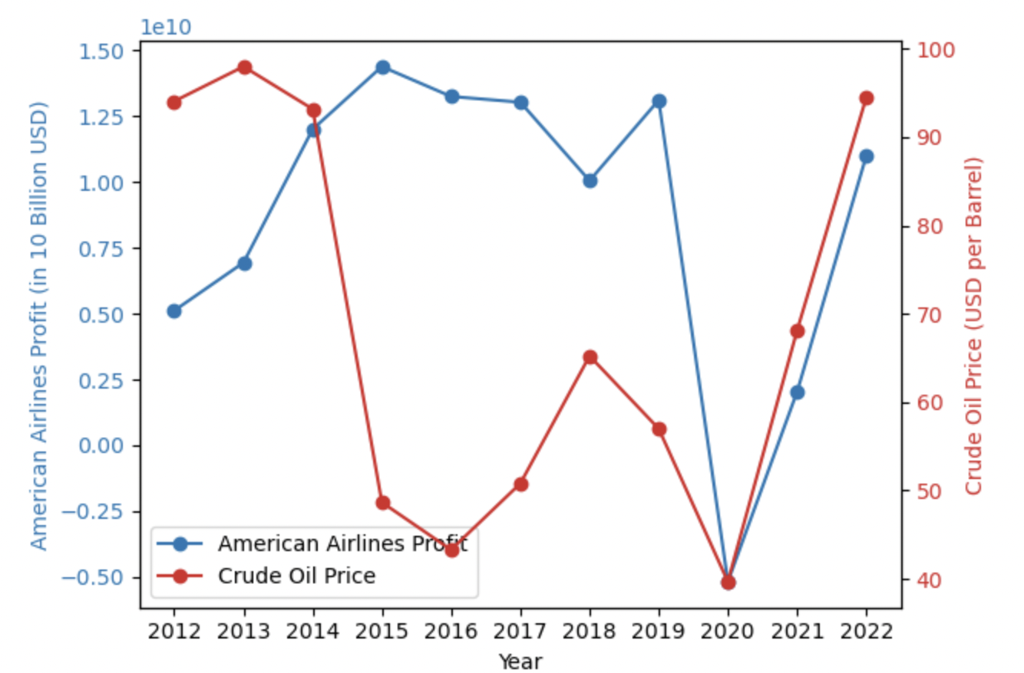
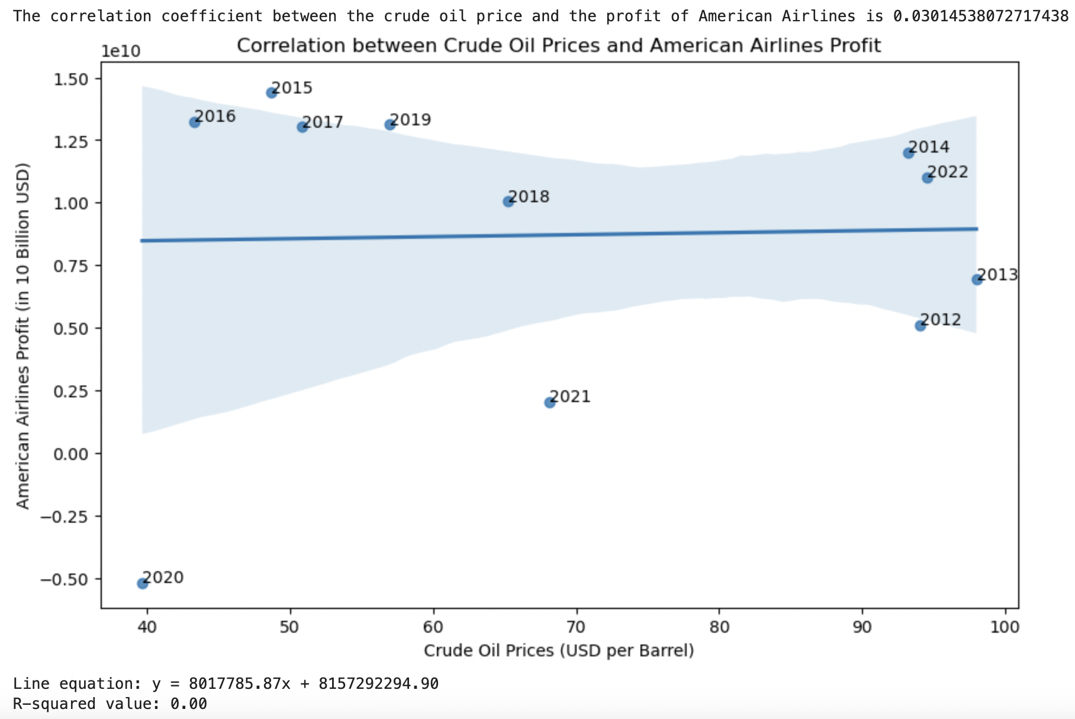
American Airlines
American Airlines:
In 2020, they faced a net loss of -$5.19 billion.
Their revenue figures have fluctuated over the years.

Slide 7
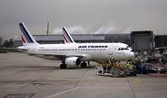
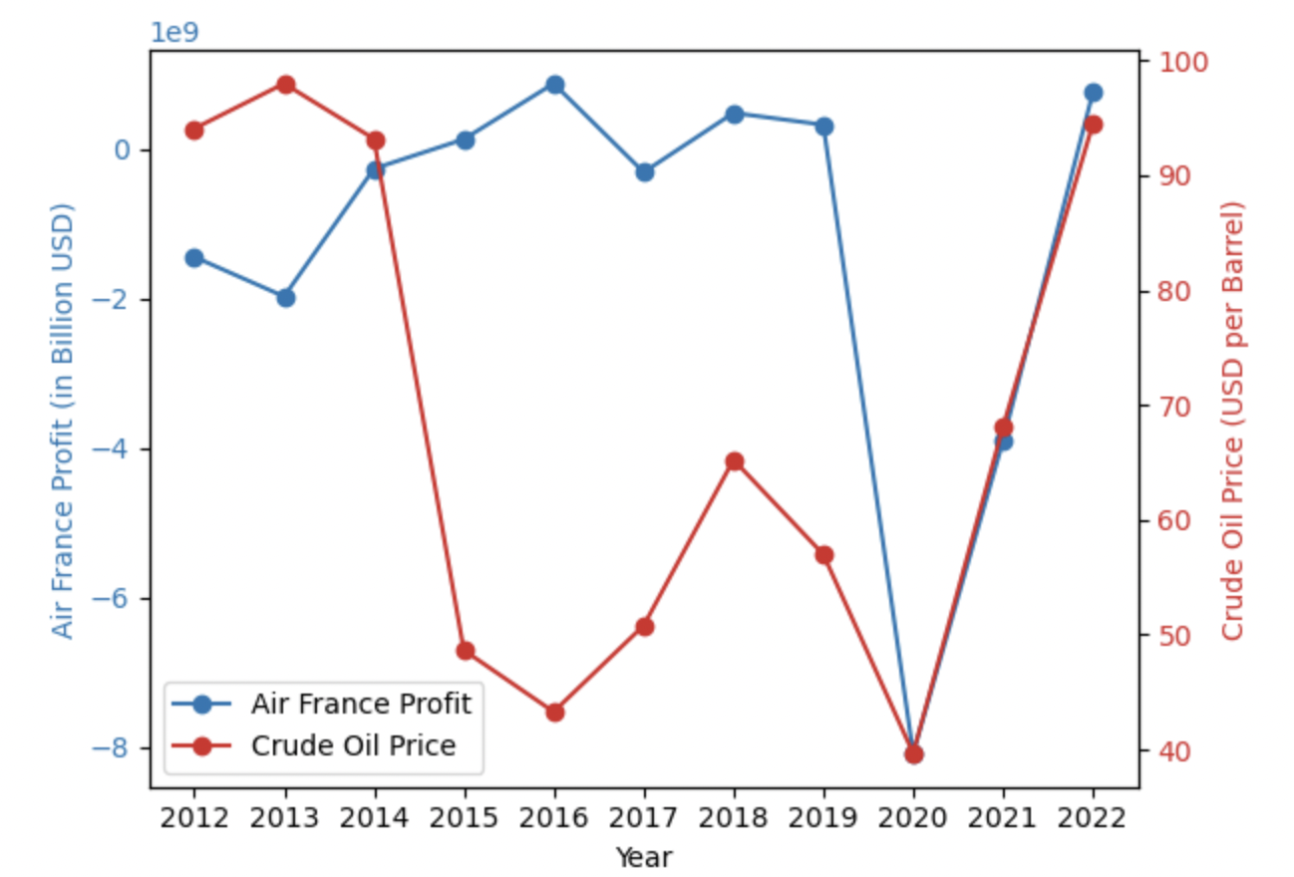
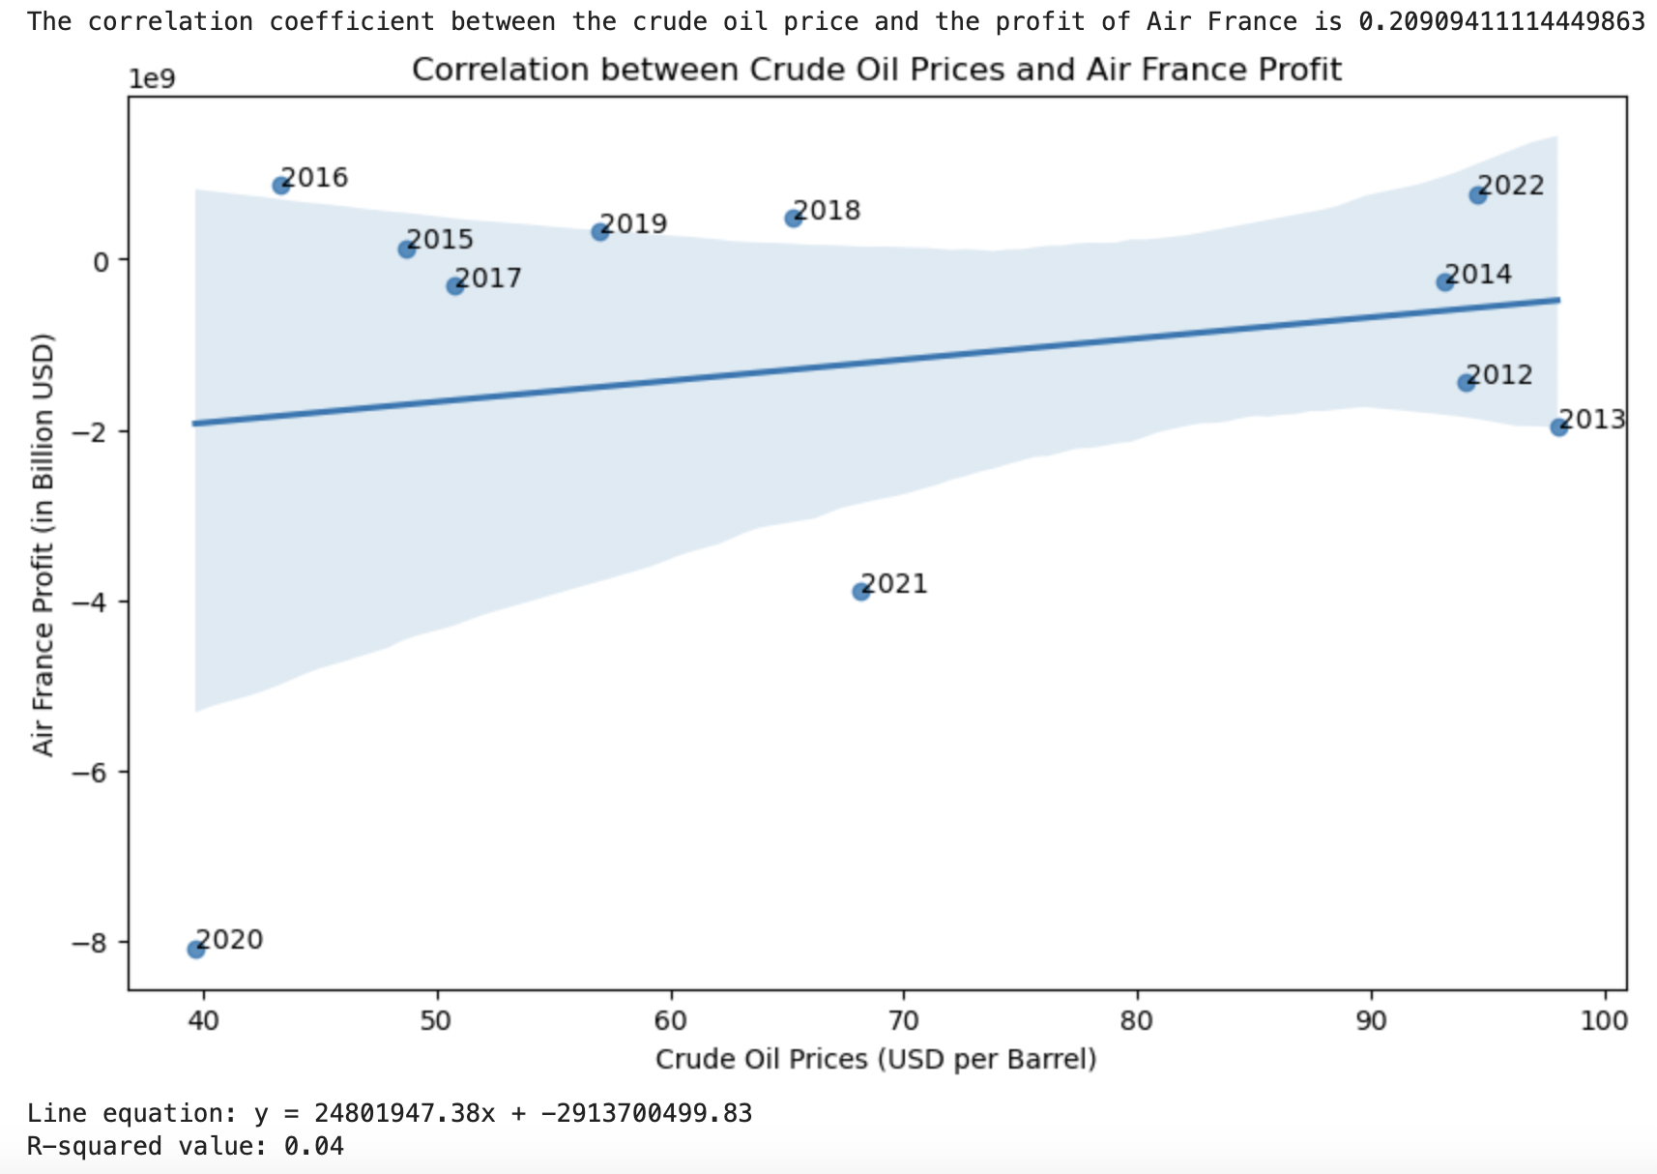
Air
France
Air France:
1. Experienced significant losses in 2020 (-$8.09 billion).
Their financial performance has been volatile.

Slide 8
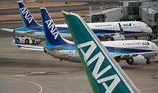
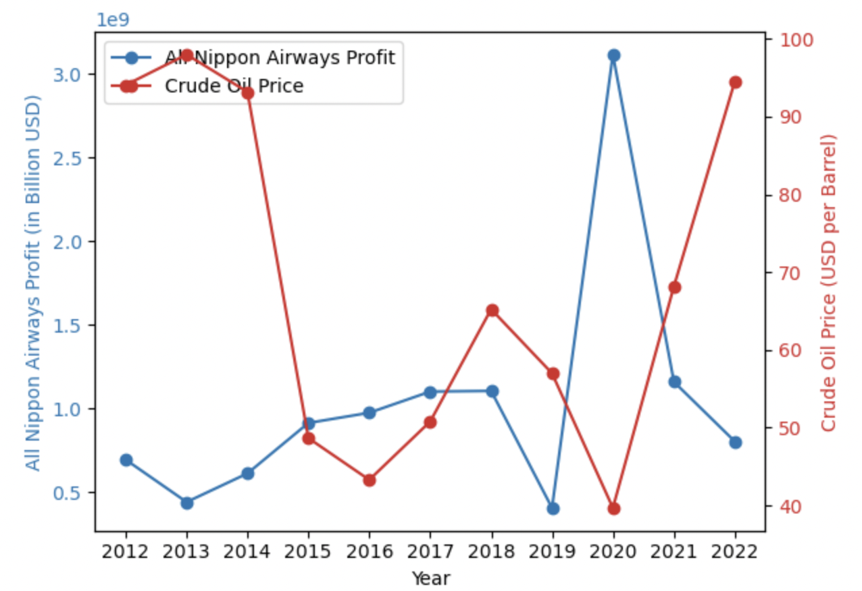
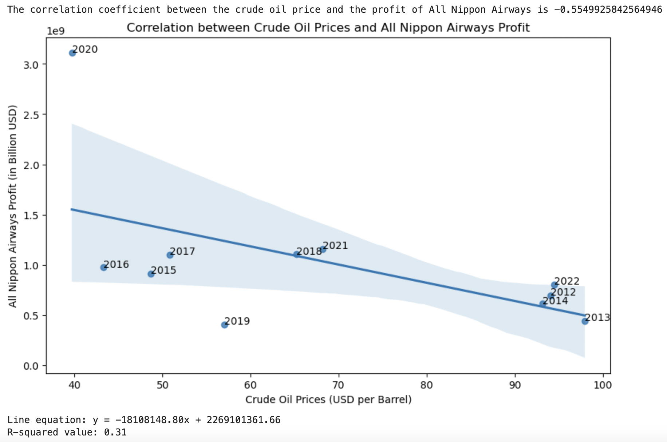
All Nippon
Airways
All Nippon Airways (ANA):
1. Remained relatively stable, with a peak in 2020 ($3.11 billion).
2. Managed to maintain profitability.

Slide 9
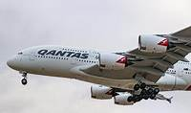
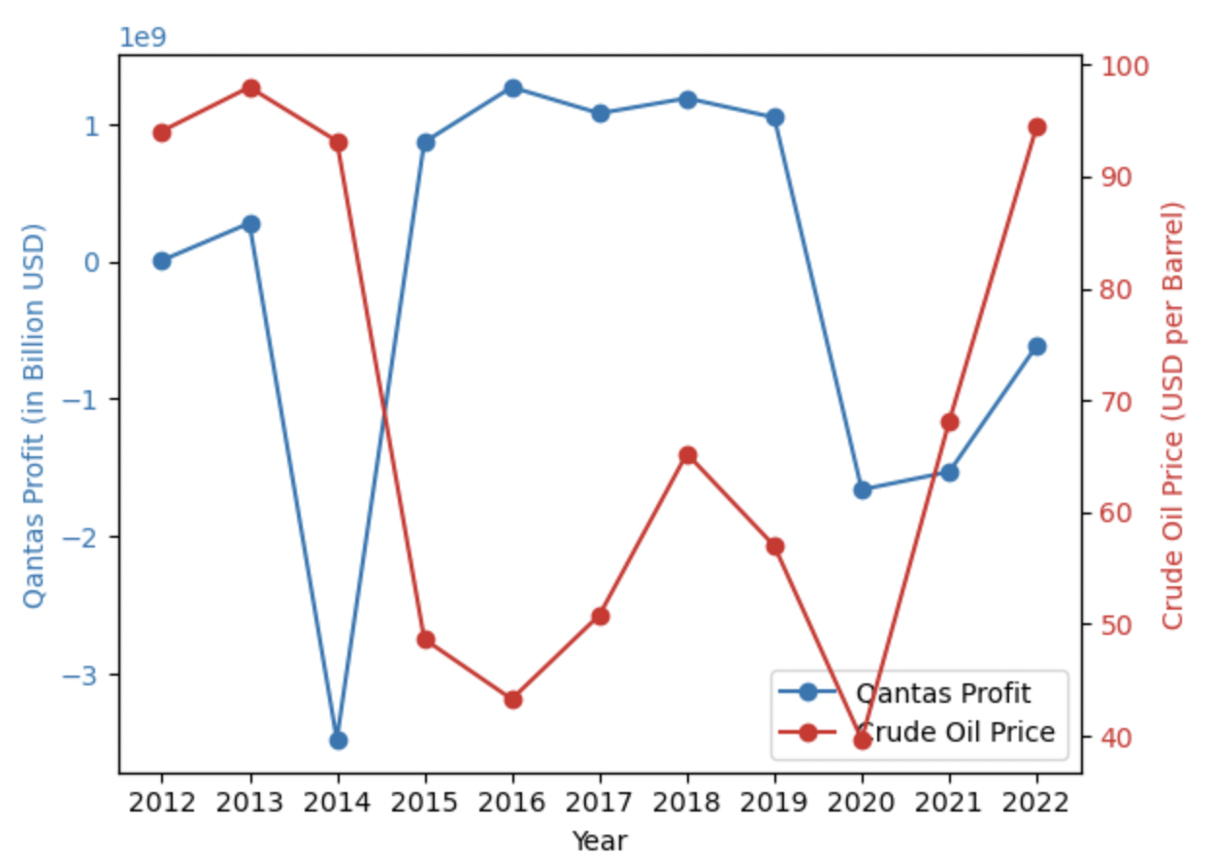
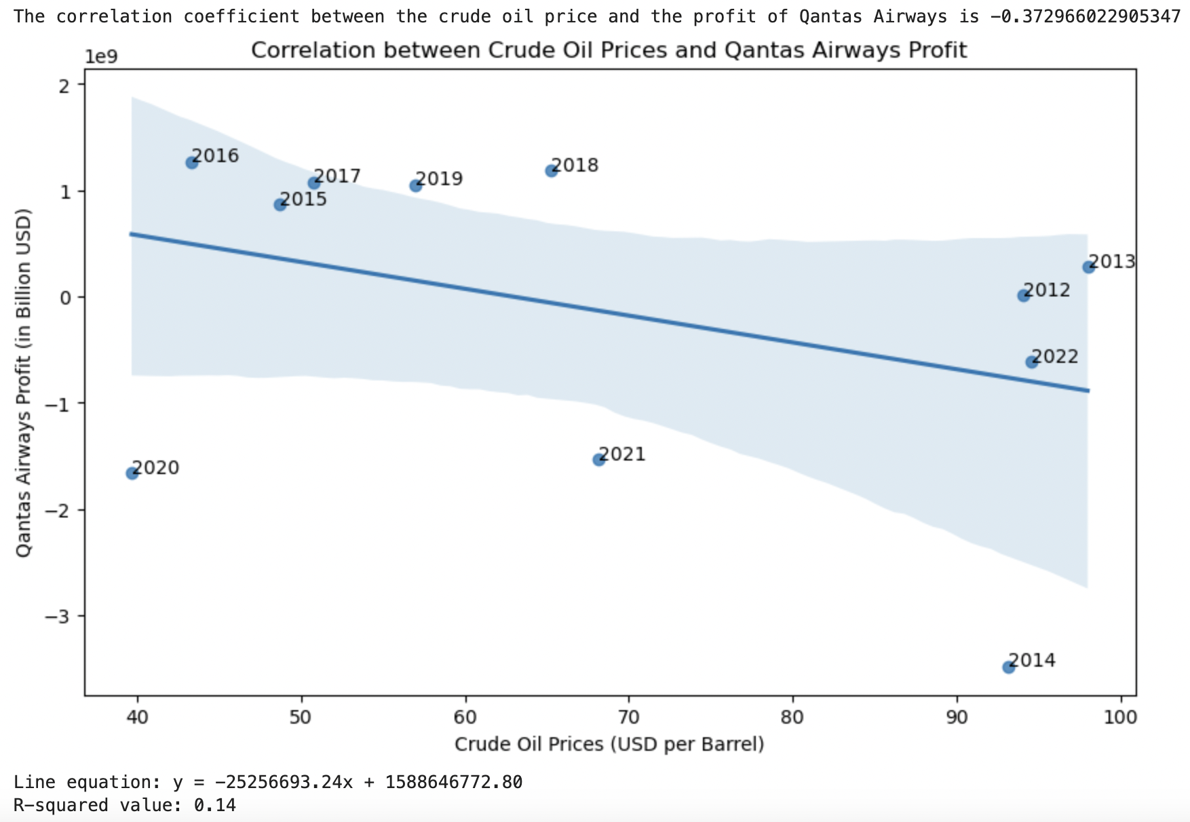
Qantas
Airways
Qantas Airways:
1. Faced losses in 2014 and 2020, with the lowest revenue at -$3.48 billion.
2. Their financial performance has been challenging.

Slide 10
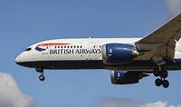
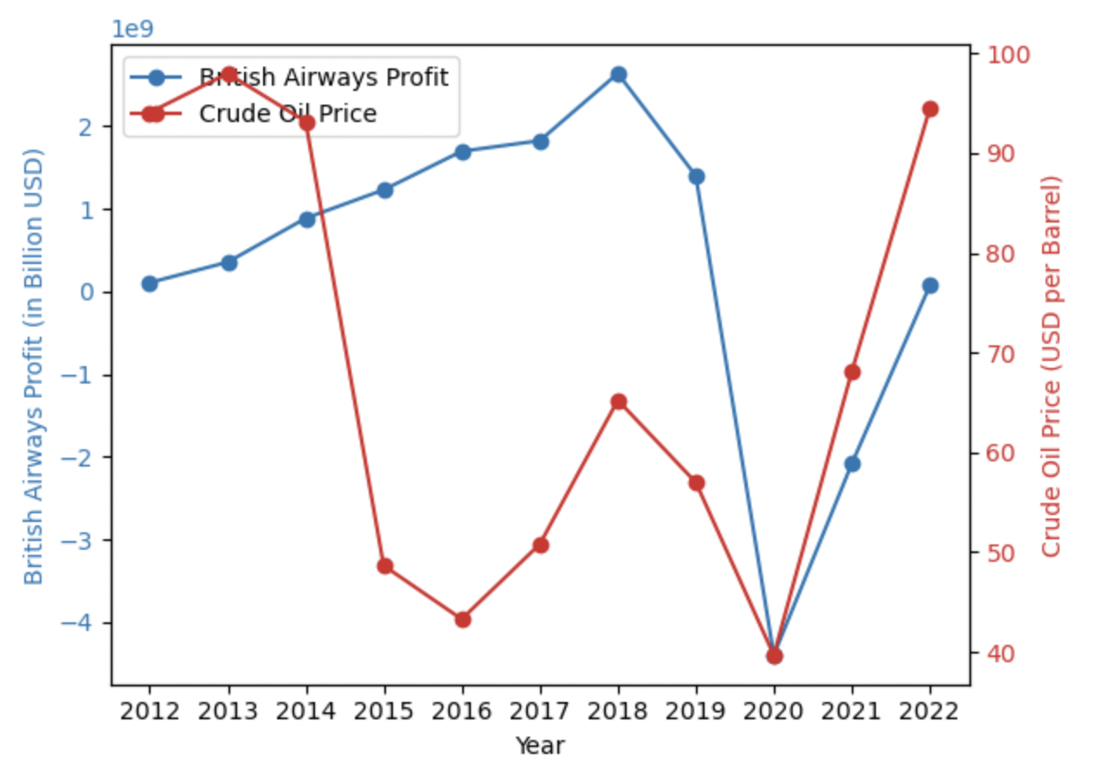
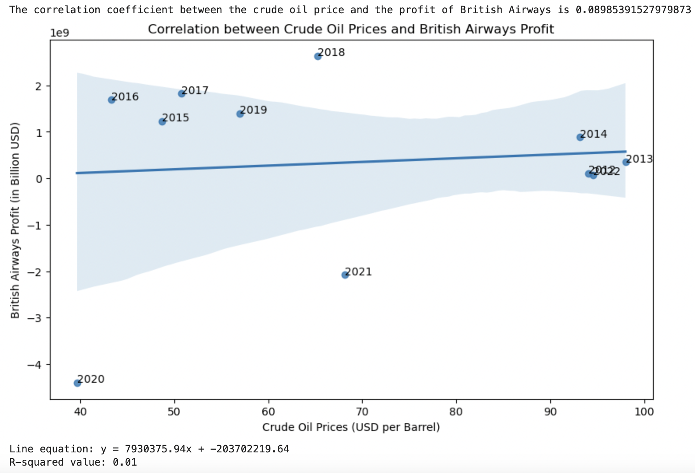
British Airways
British Airways:
1. Revenue fluctuated, reaching a high of $2.64 billion in 2018.
2. Managed to stay profitable.

Slide 11

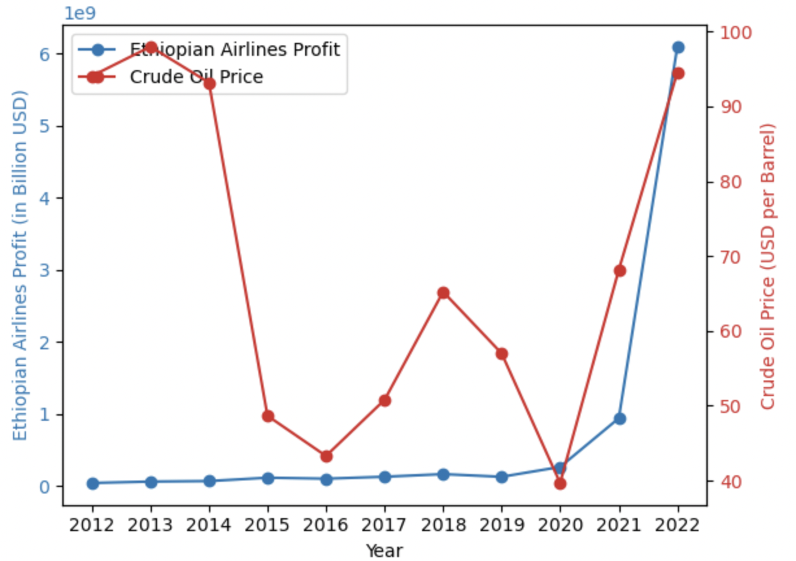
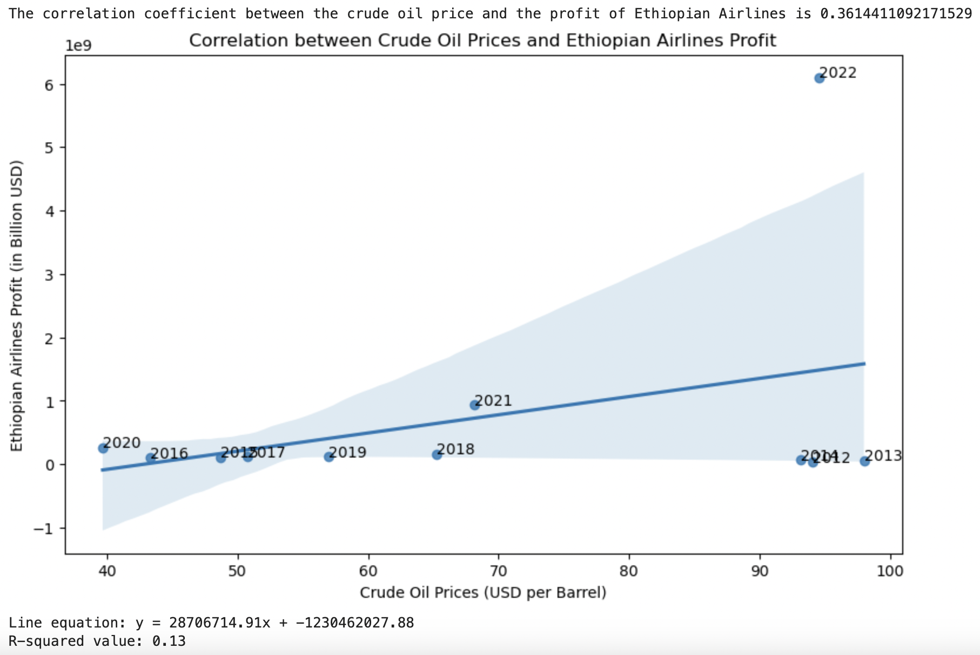
Ethiopian Airlines
6.Ethiopian Airlines:
1. Consistently profitable, with a peak in 2022 ($6.10 billion).
2. Demonstrated resilience.

Slide 12
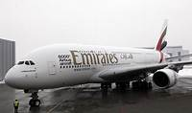
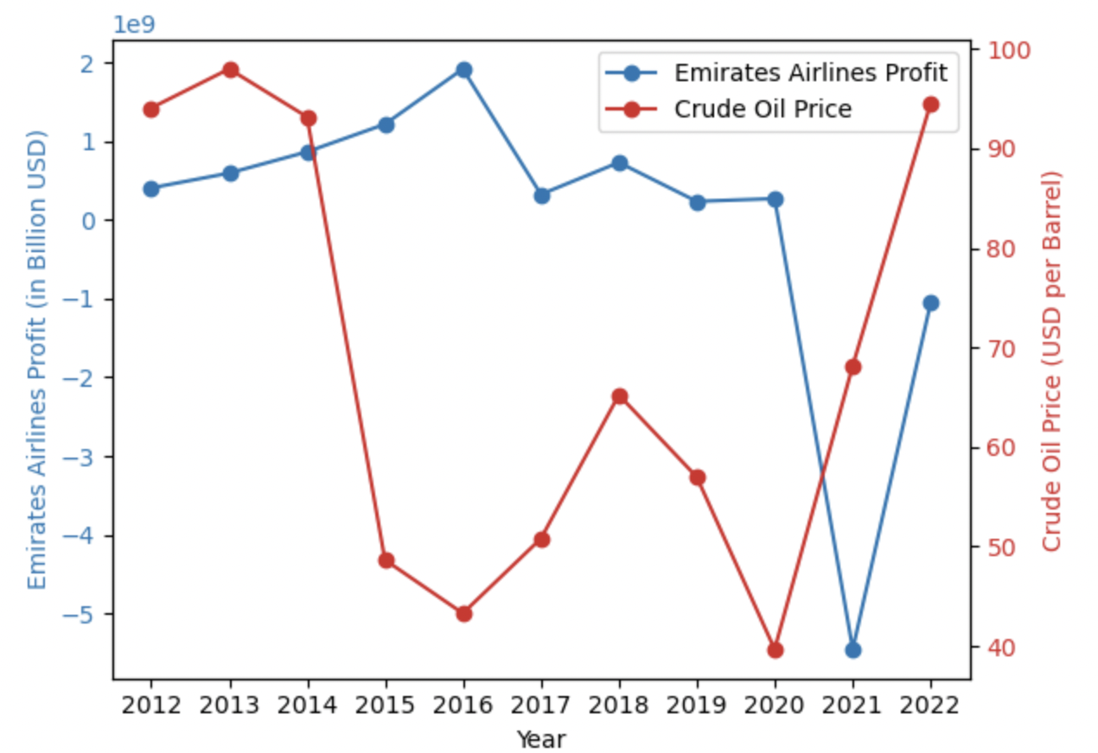
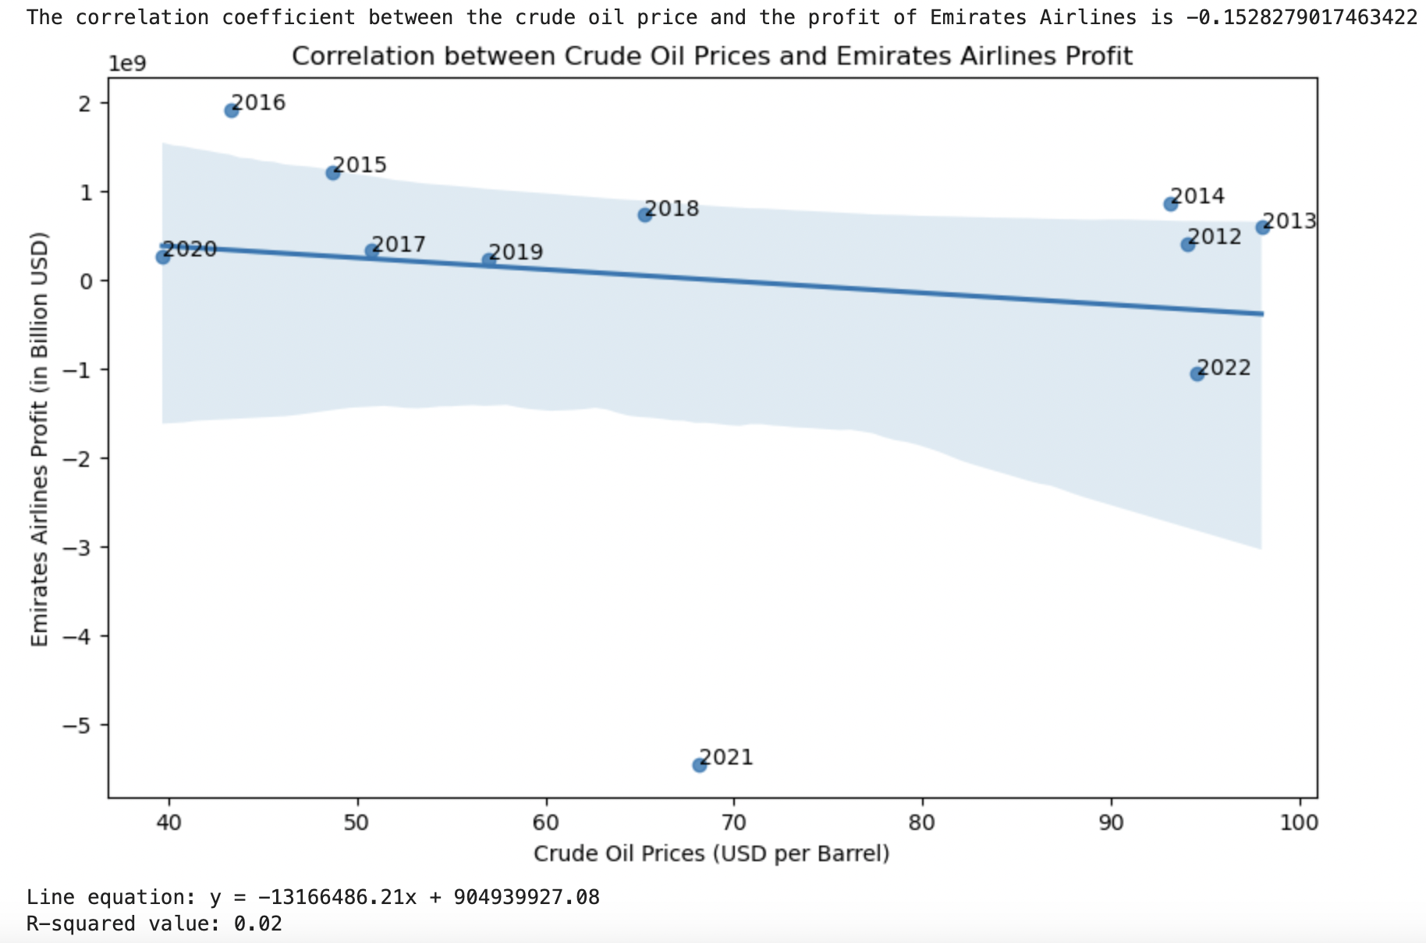
Emirates Airlines
7. Emirates Airlines:
1. Faced losses in 2021 (-$5.45 billion).
2. Their financial performance has been mixed.

Slide 13

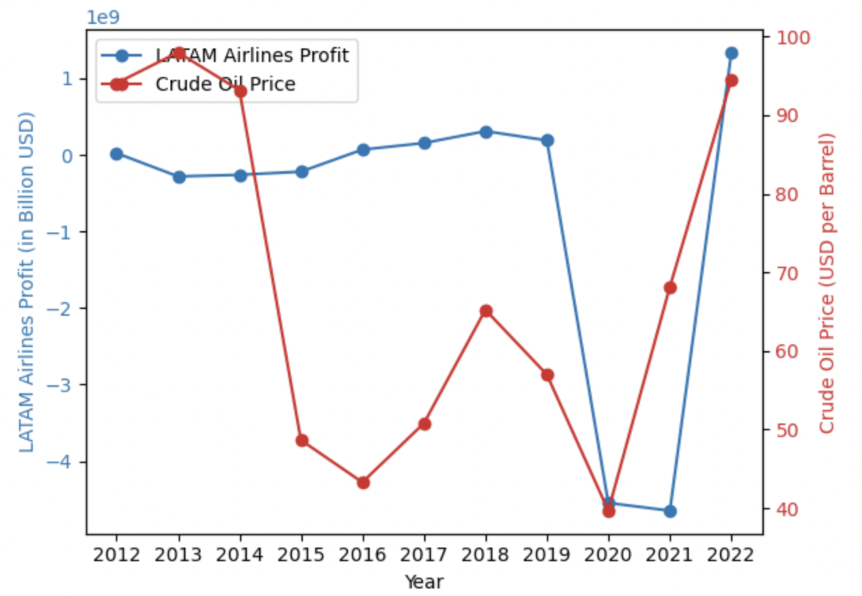
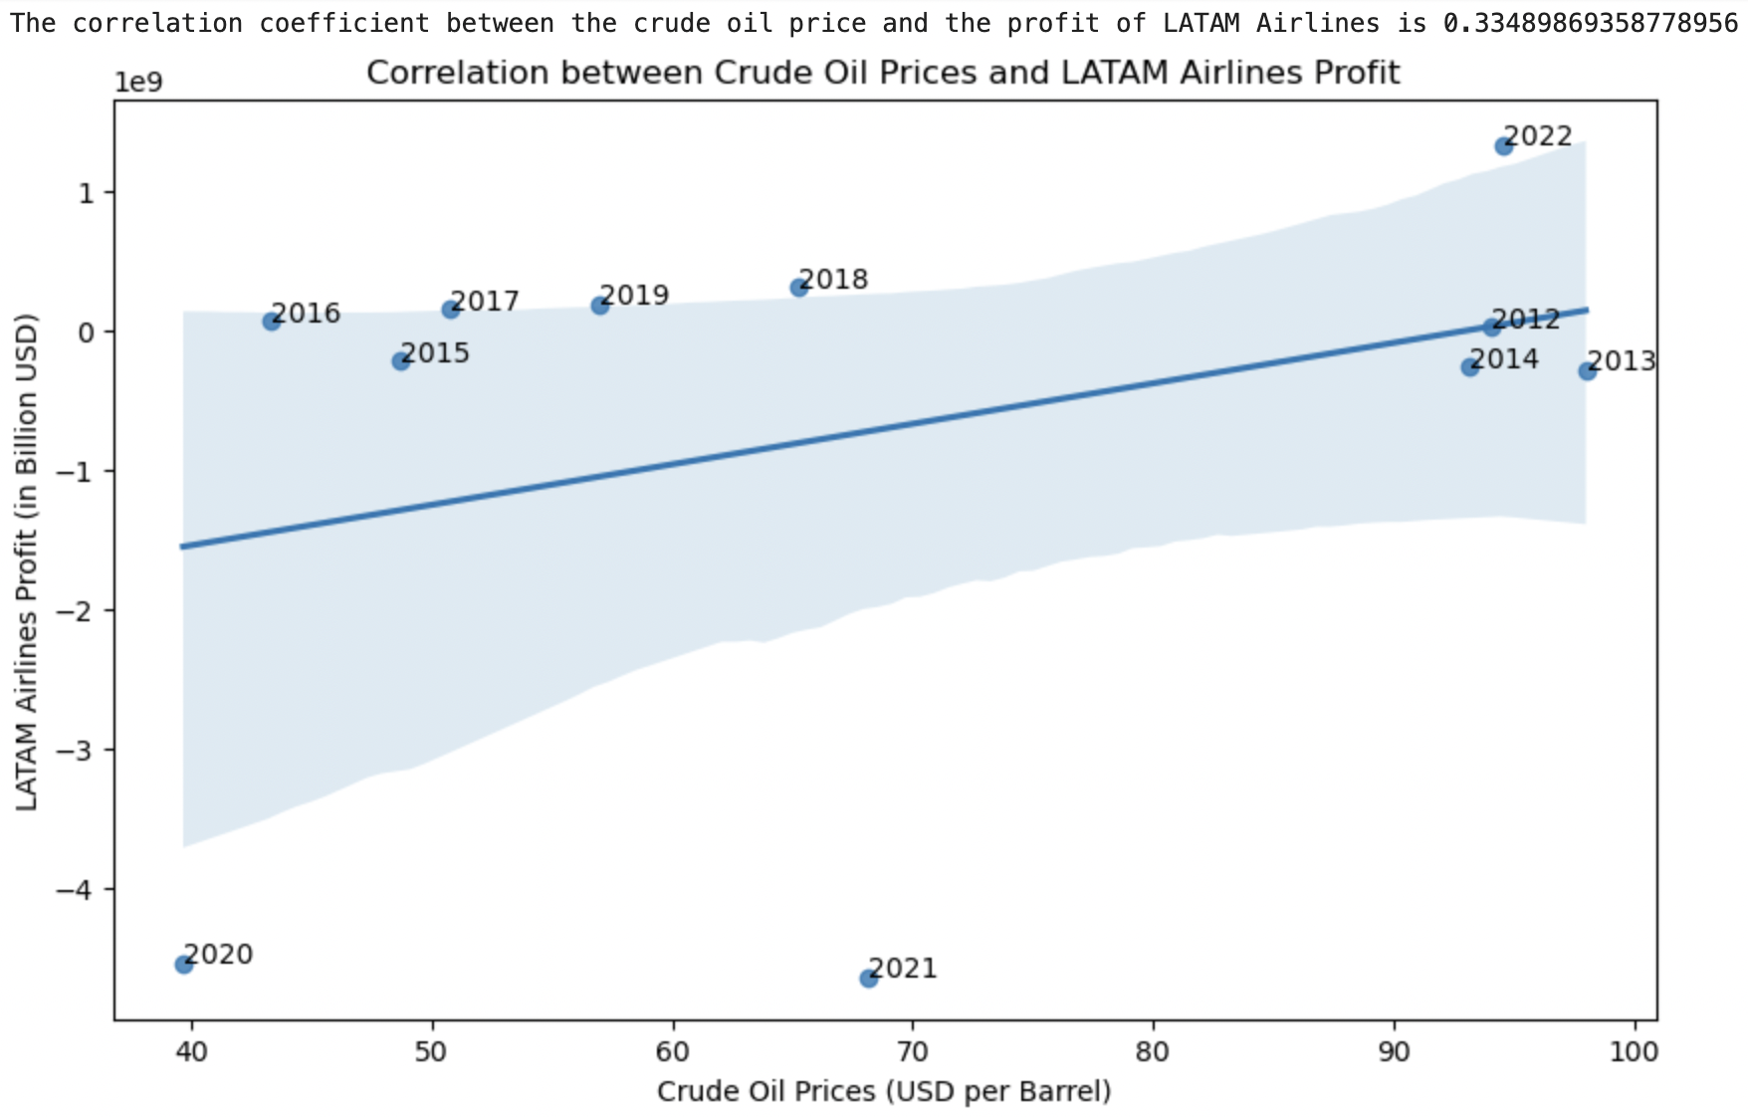
LATAM Airlines
8. LATAM Airlines:
1. Experienced significant losses in 2020 and 2021(>-$4.55 billion).
2. Managed to stay profitable.

Slide 14

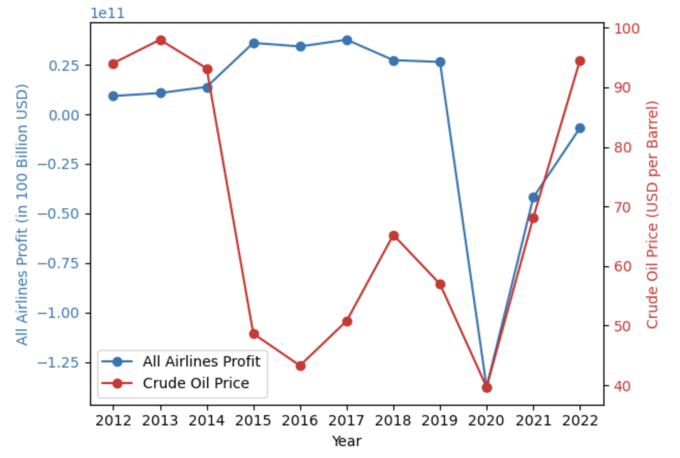
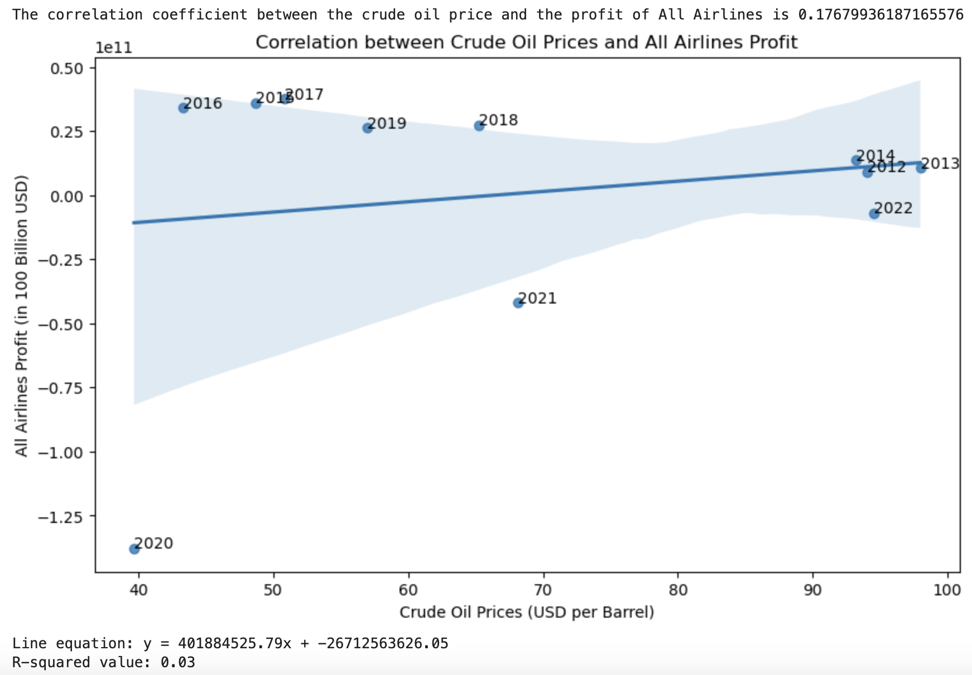
Global Airlines
All Airlines:
In 2020, they faced a net loss of -$137.7 billion due to Covid-19 restrictions.
Their revenue figures have fluctuated over the years.

Slide 15
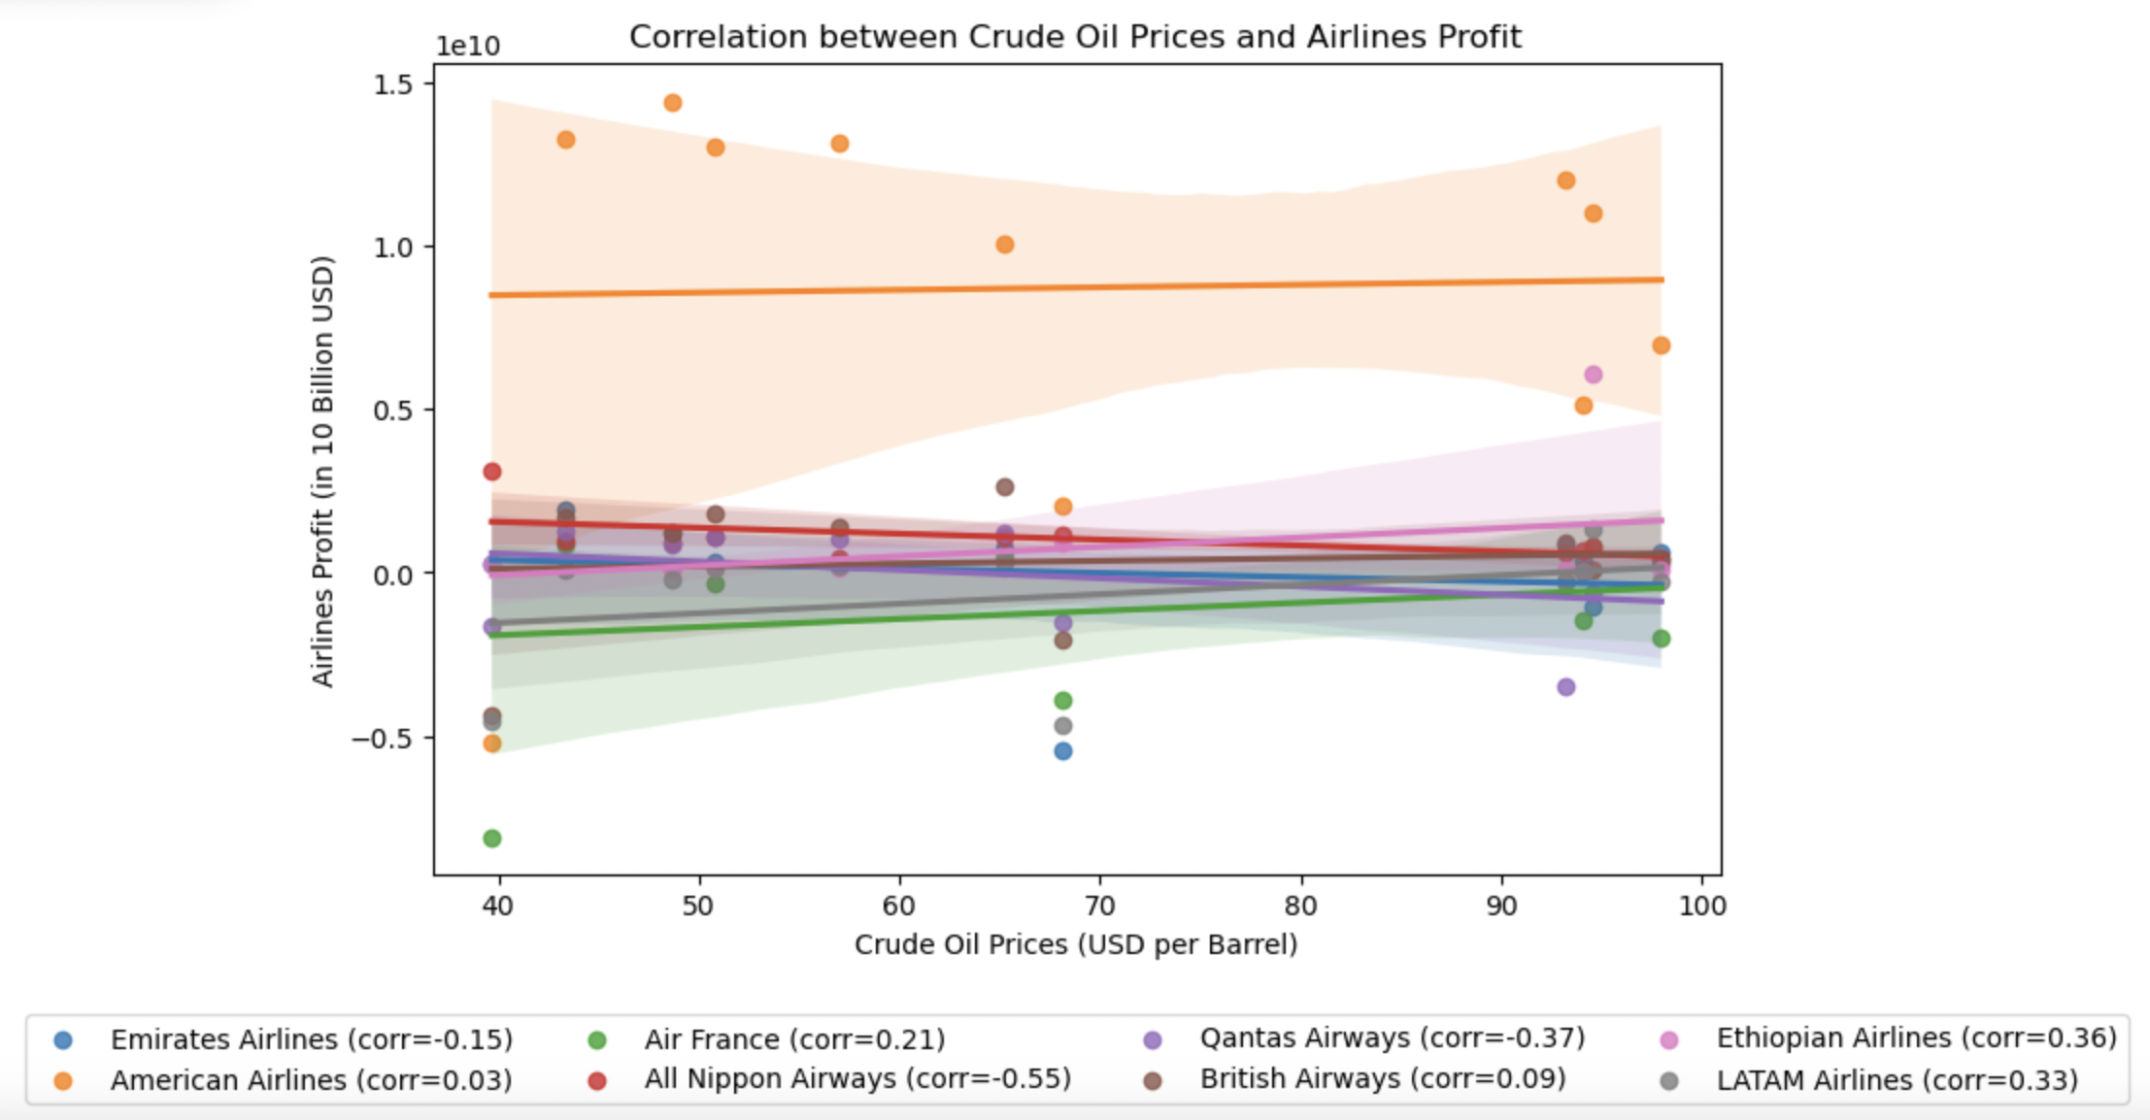
Correlation between Crude oil Price and Airlines Profit
Q. Are there identifiable patterns or trends in the impact of crude oil trade price fluctuations and Airline price fluctuation?
Emirates: Weak positive correlation (0.15). Slightly better performance when oil prices rise.
Air France: Weak positive correlation (0.21). Follows oil price trends.
Qantas: Moderate positive correlation (0.37). Sensitive to oil price changes.
Ethiopian Airlines: Moderate positive correlation (0.36). Influenced by crude oil prices.
American Airlines: Very weak positive correlation (0.03). Other factors play a role.
Nippon Airways: Strong positive correlation (0.55). Highly sensitive to oil prices.
British Airways: Weak positive correlation (0.09). Somewhat influenced by oil prices.
LATAM Airlines: Moderate positive correlation (0.33). Relatively well-performing with oil price increases.
**Correlation doesn’t imply causation. Other factors also impact airline performance.

Slide 16



